Slide 1
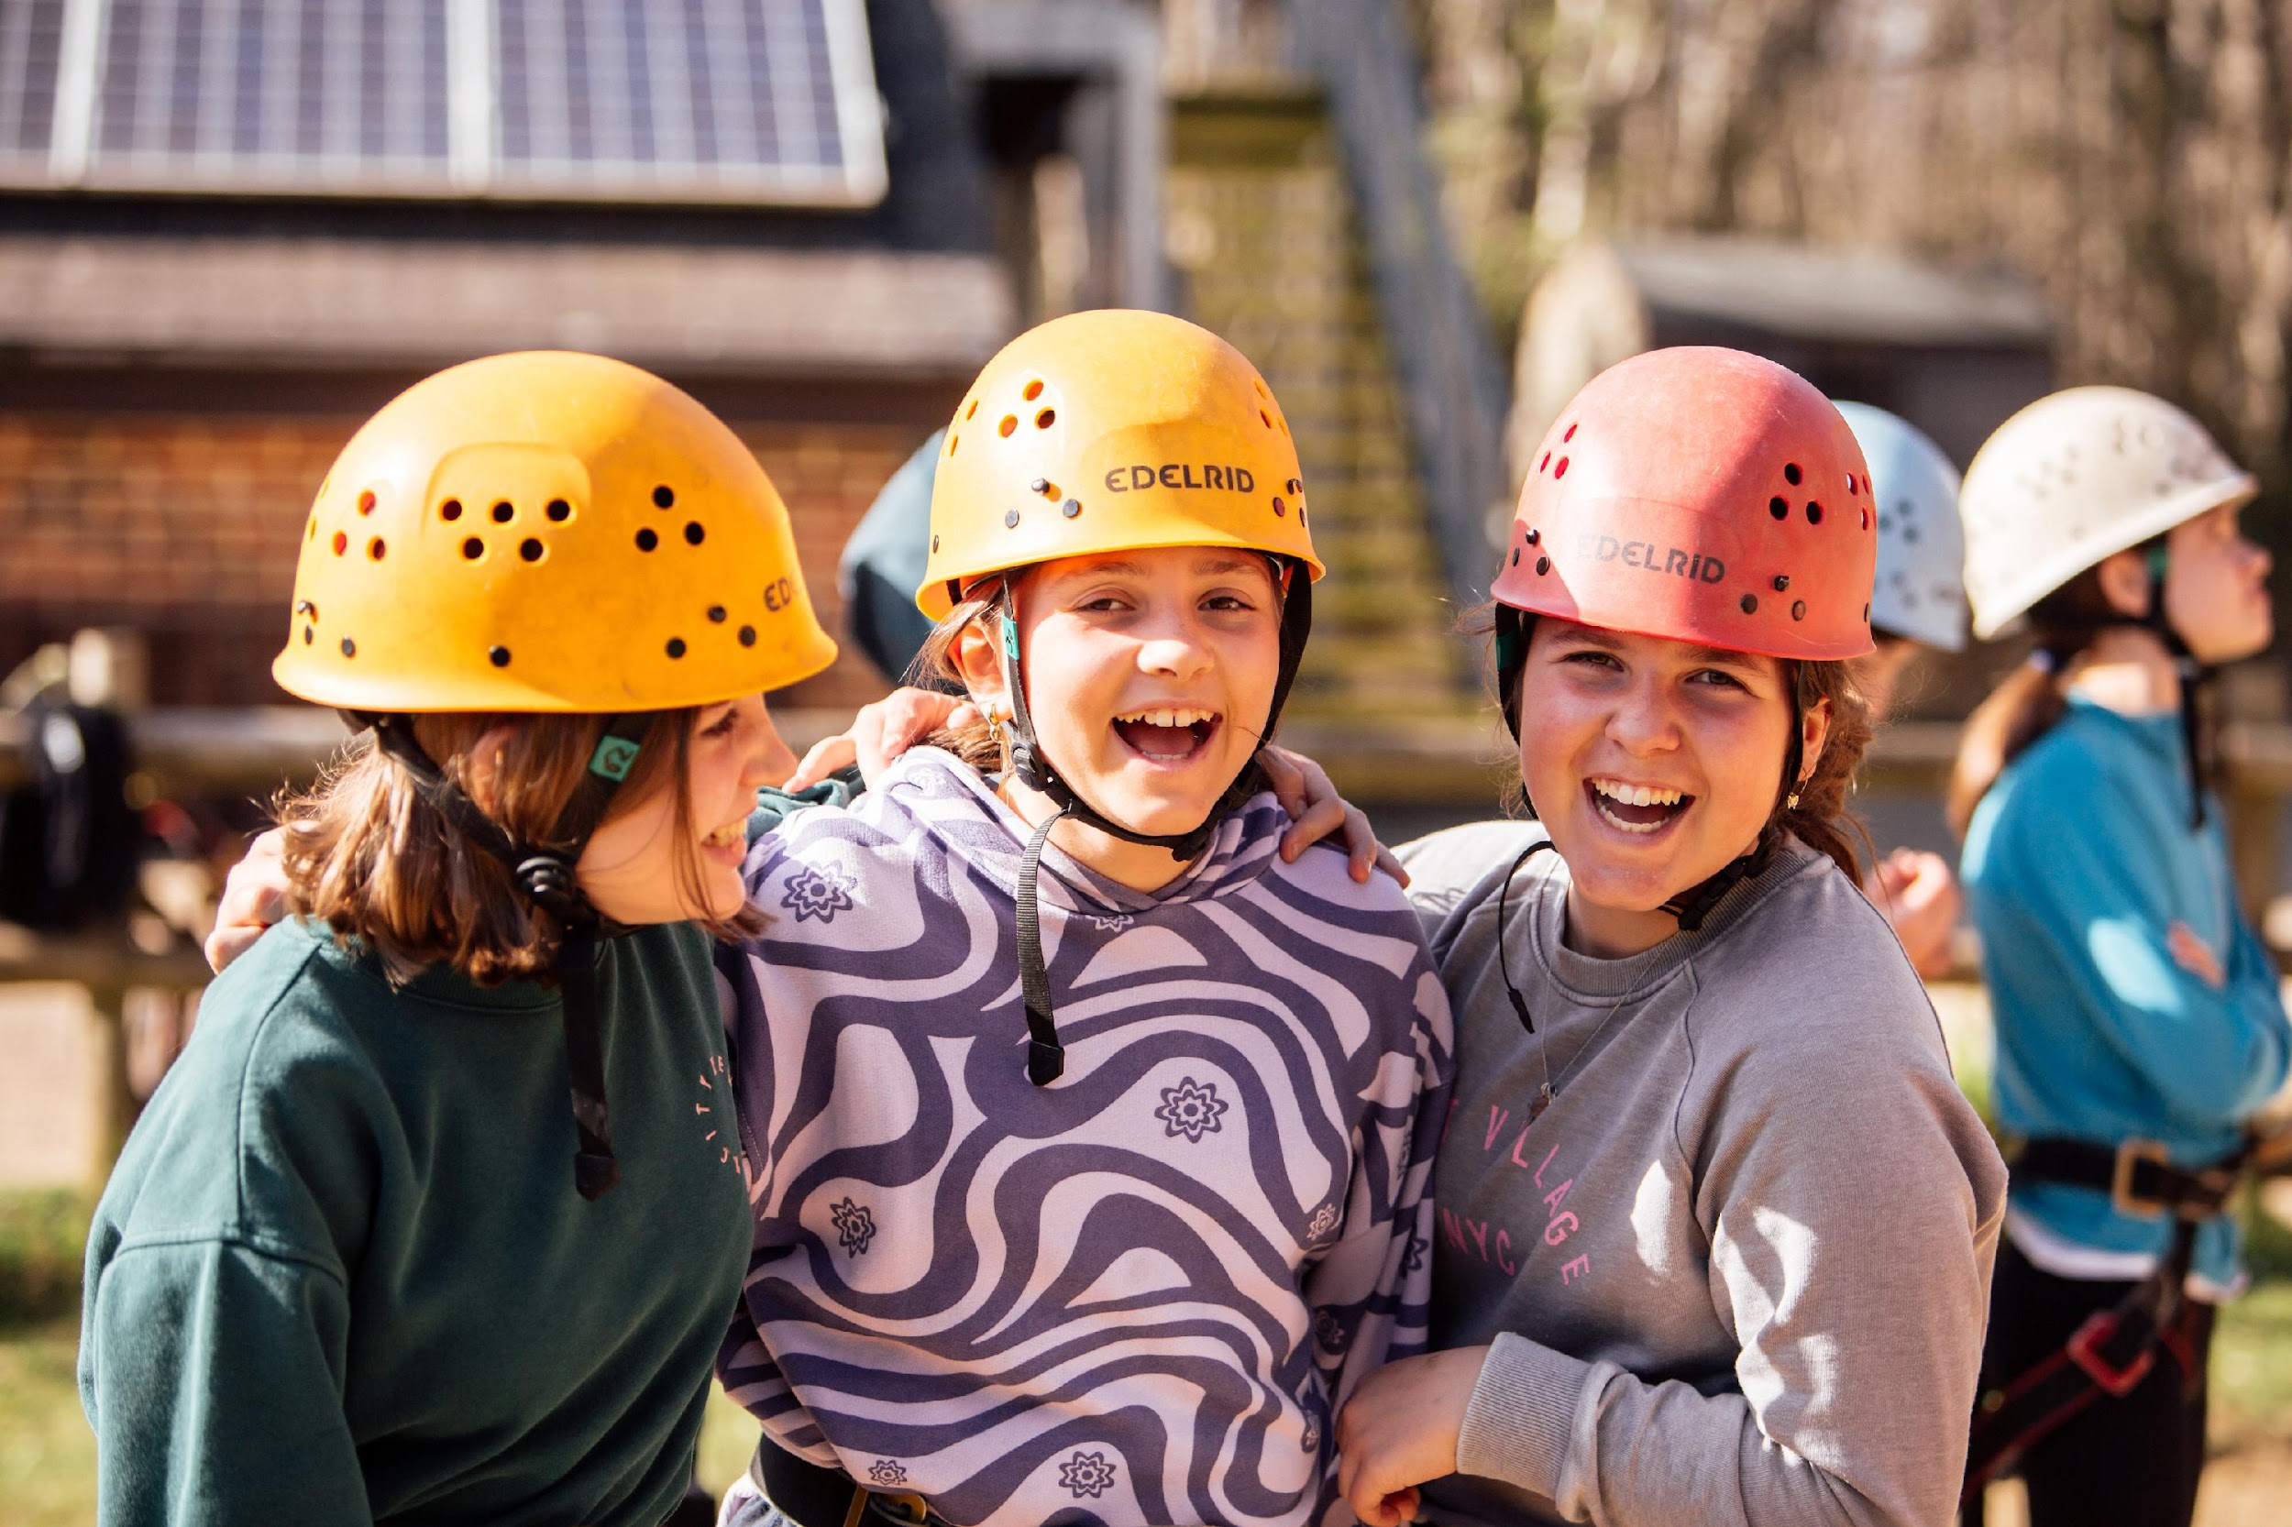

Photography Briefing
2026

Slide 2
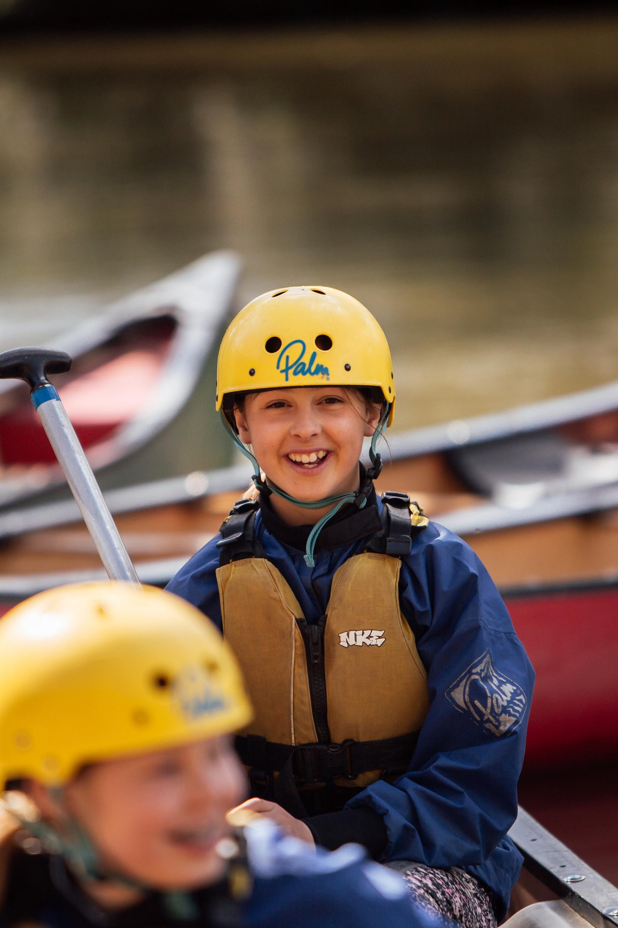

  THE ASK
AT EVENT
    Block out 1-2 hours a day
    Feel empowered to do this - IMPORTANT!
    Tell people.
AFTER EVENT
    Send media to ST within a week - via Google Drive shared folder or WeTransfer
    No intense editing - raw photos
    High quality - 5MB+ (photos) 4K (video)
    Best photos - not 1000s!- spirit of event not ‘diary’

Slide 3
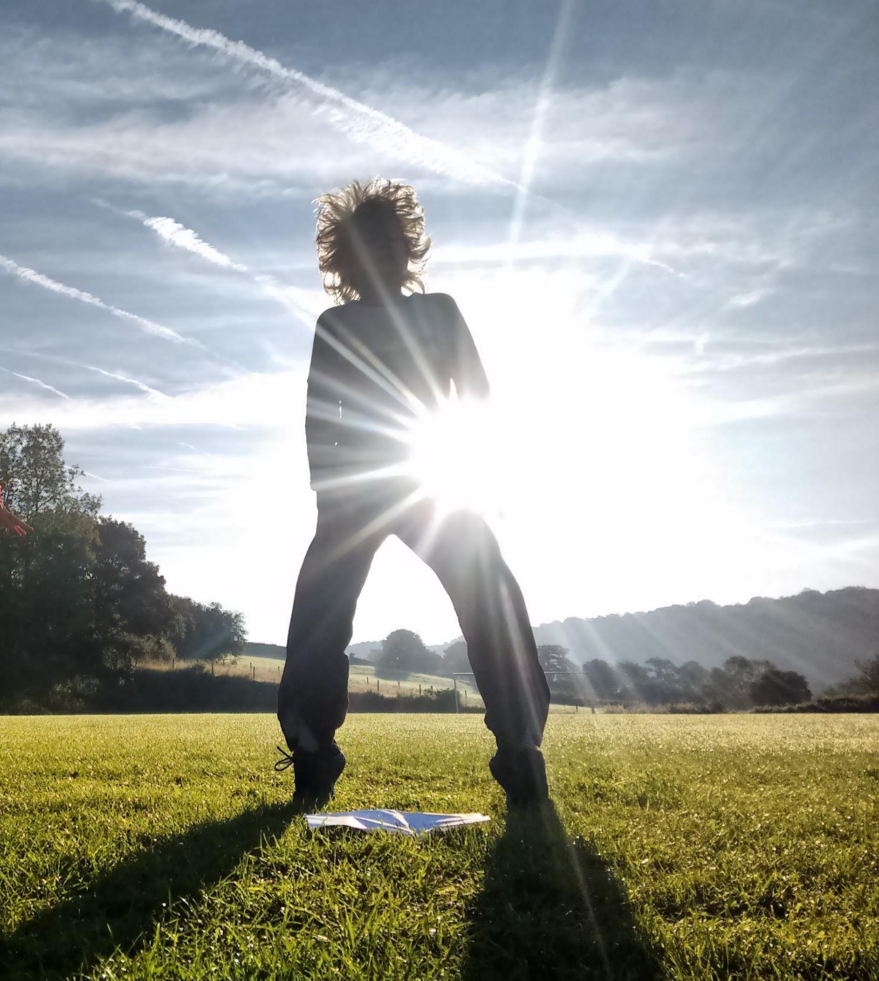

  PHOTOS
1. Ensure good quality
    Lots of natural light!
    Low aperture = blur backgrounds
    High shutter speeds for movement
2. Shoot in landscape & portrait
3. Build trust!
    Make people feel comfortable & at ease

Slide 4
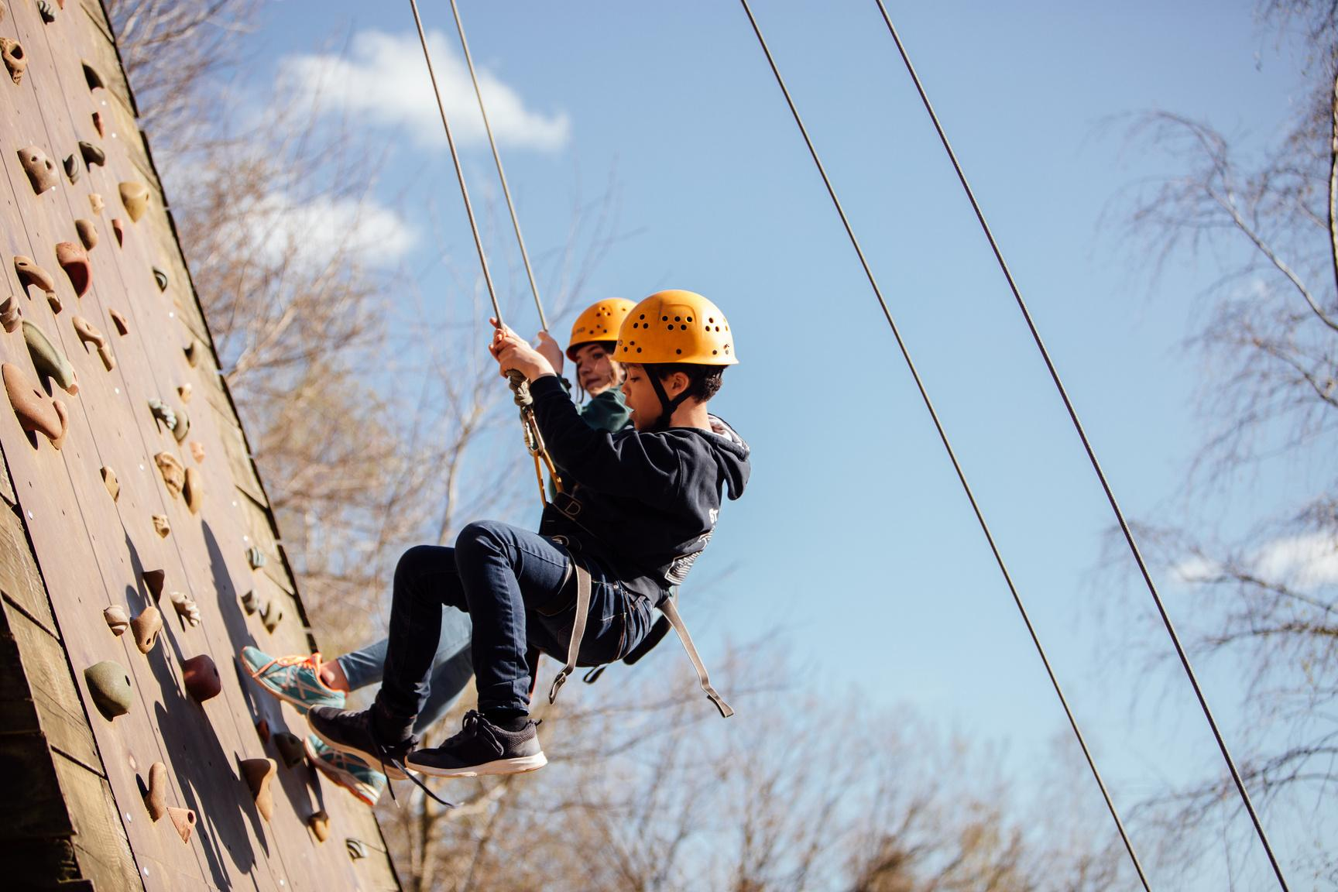
VIDEO
1. Landscape & portrait
  Landscape for website. Portrait for socials.
  If in doubt shoot in landscape!
2. Good quality
  Highest resolution (4K if possible)- specific iPhone settings
  Good light
3. Short & snappy
  5-10 sec clips to stitch together
  No long, static, shaky clips – keep dynamic
  Longer clips - clear moment for cut down if needed

Slide 5
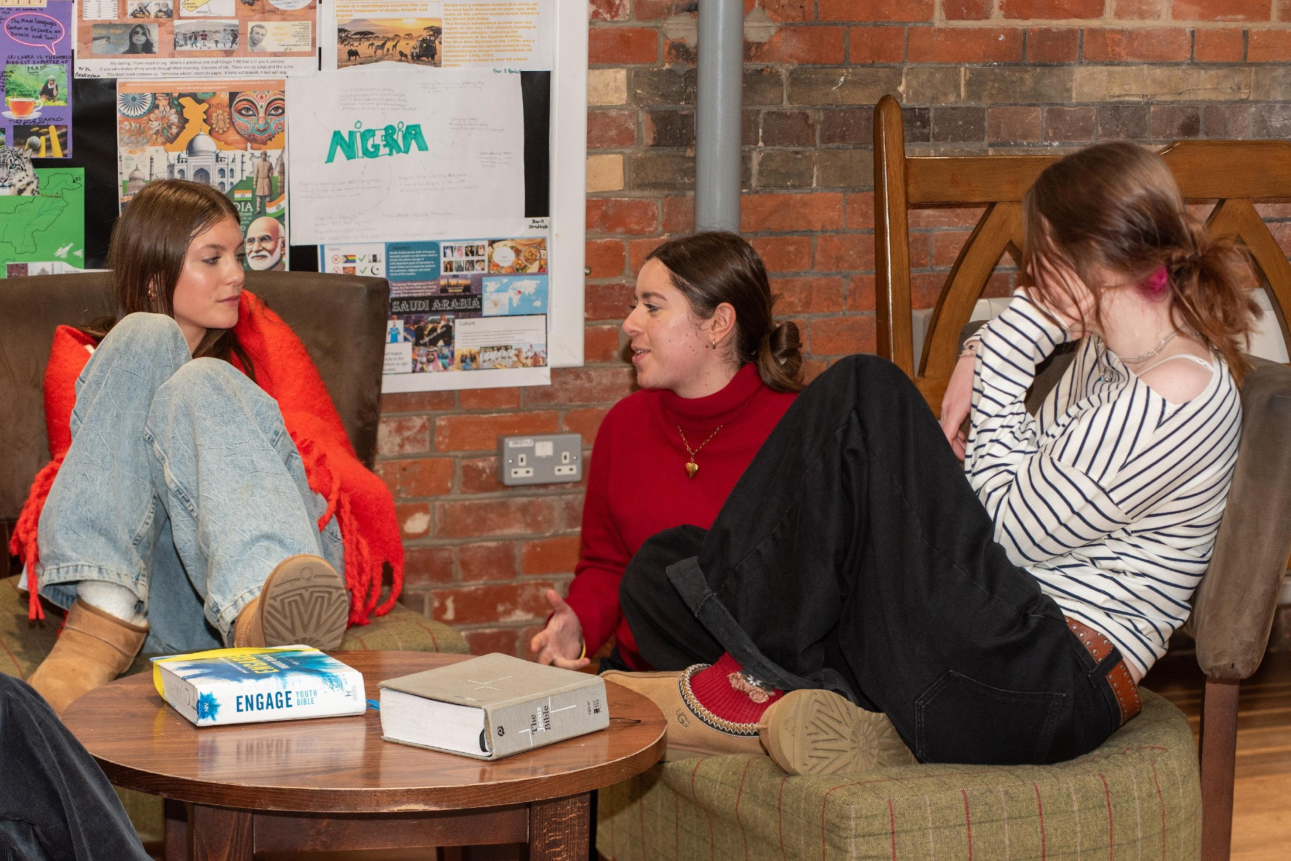
  BACKGROUNDS
  AVOID MESS!

Slide 6
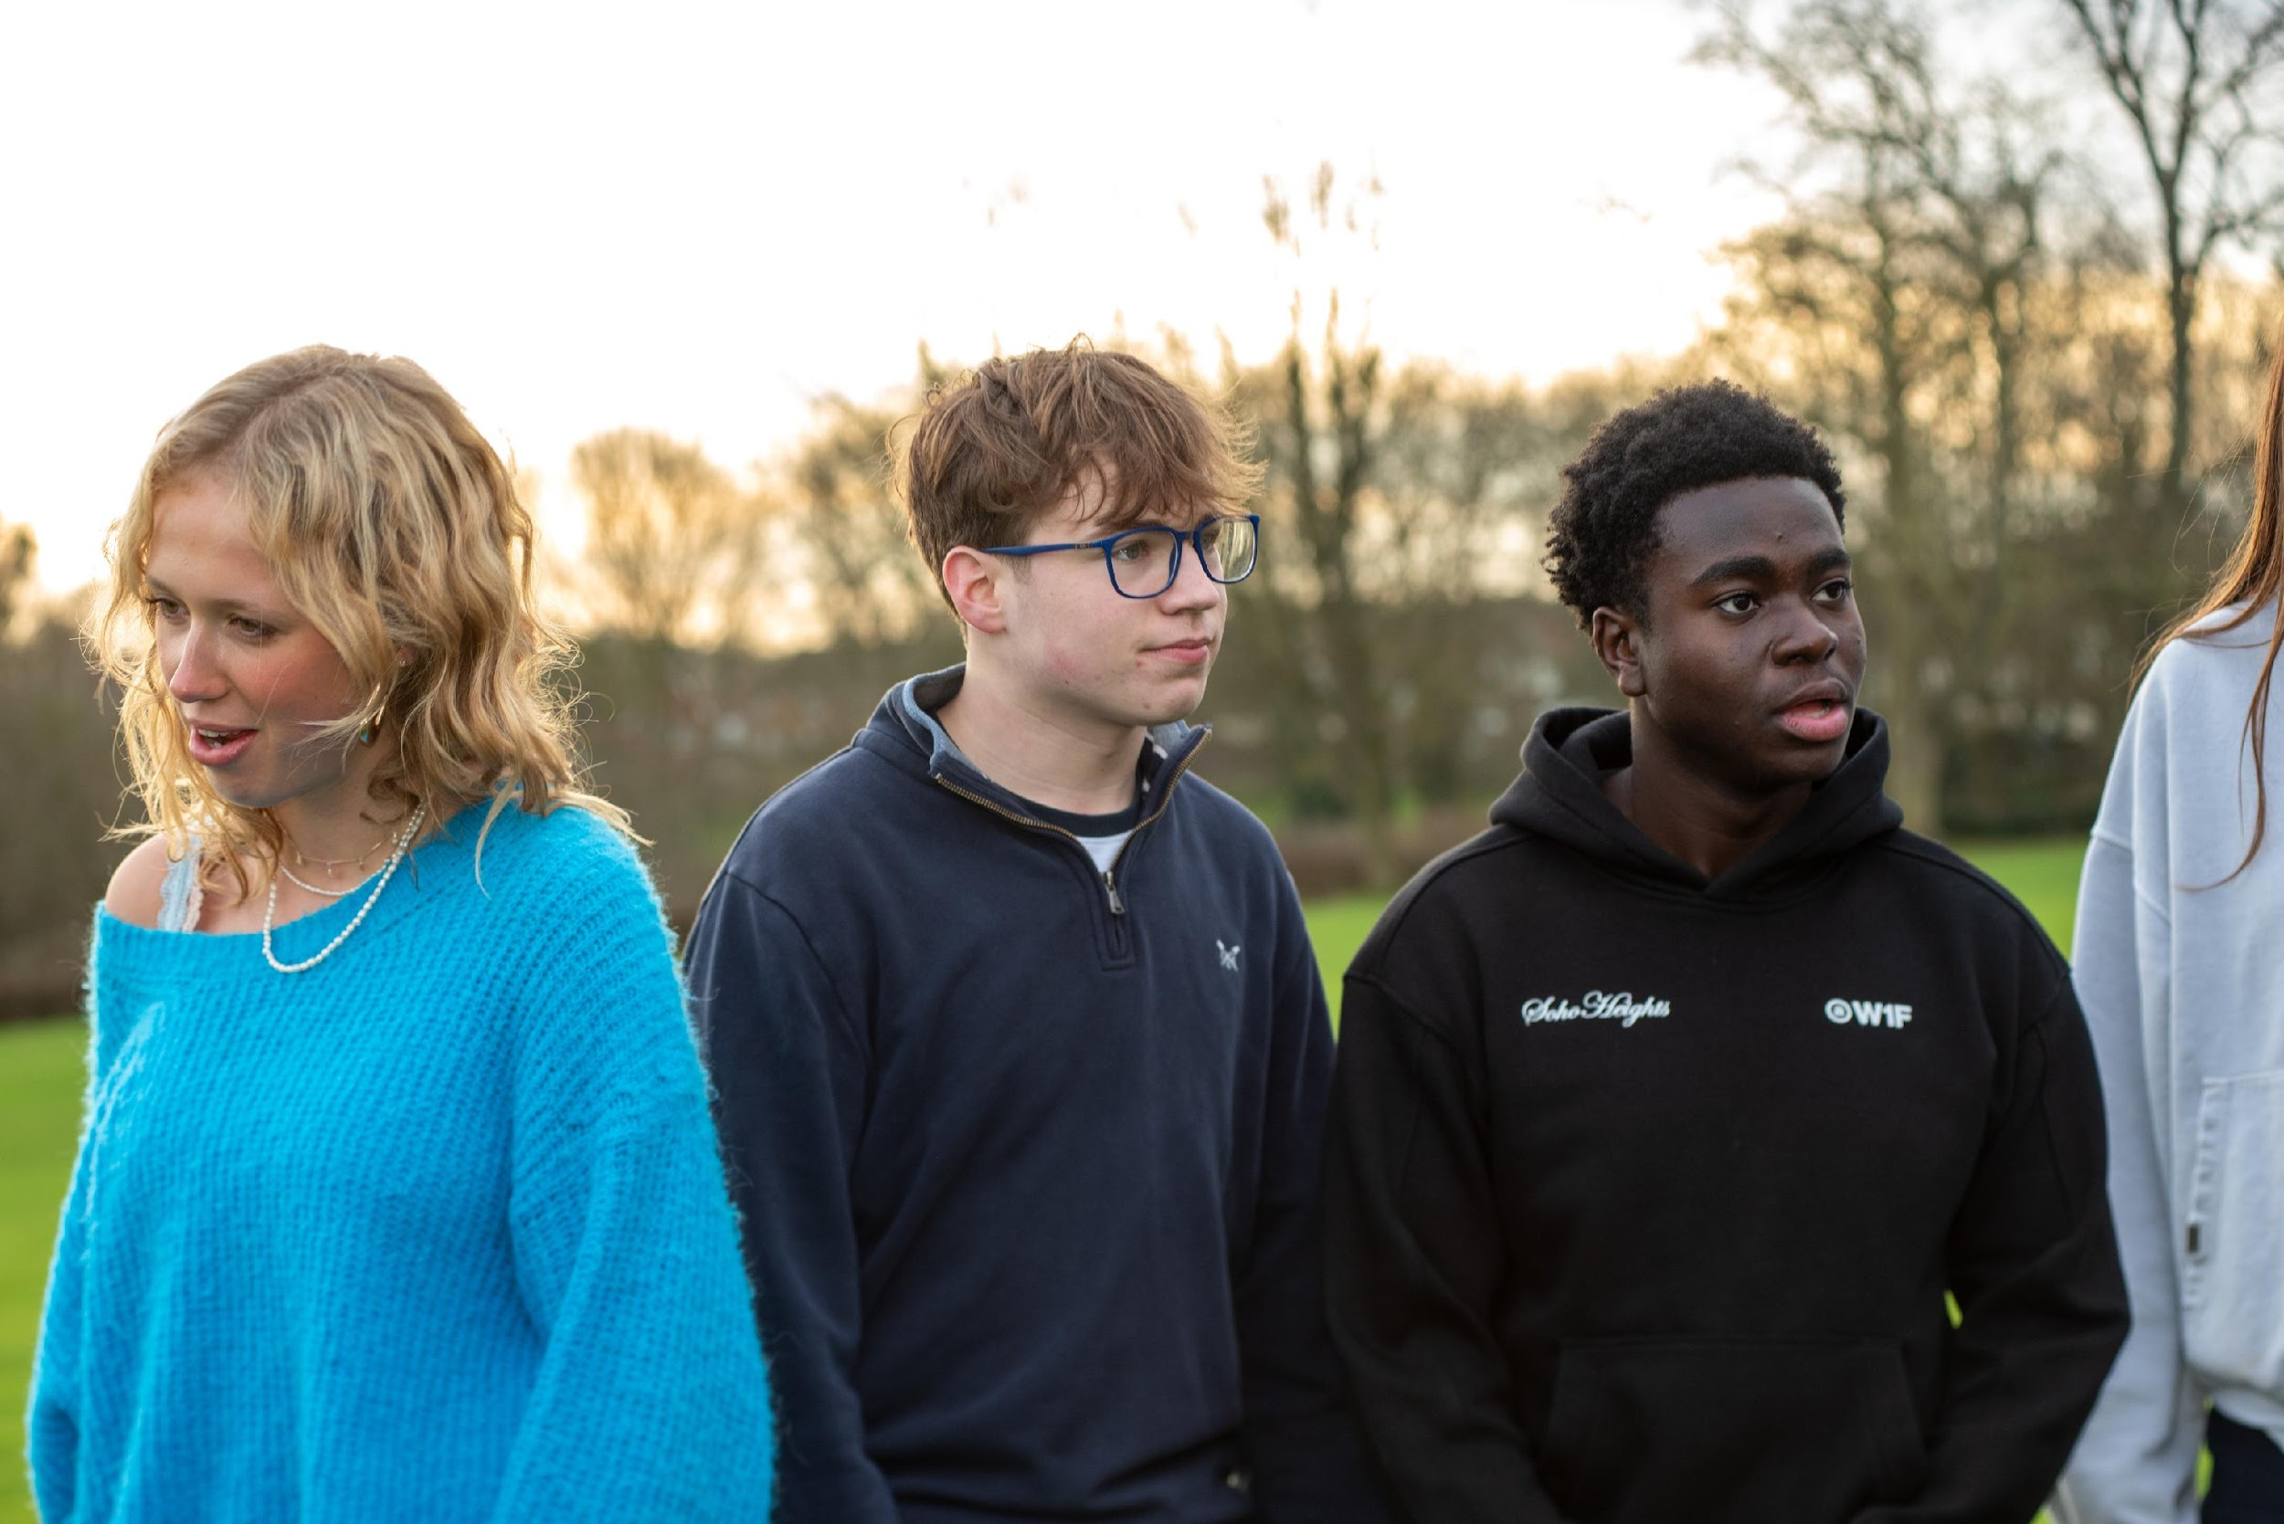
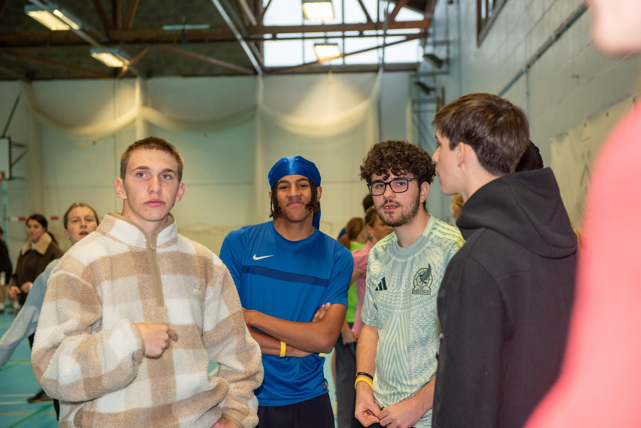
AVOID
  DISENGAGEMENT

Slide 7
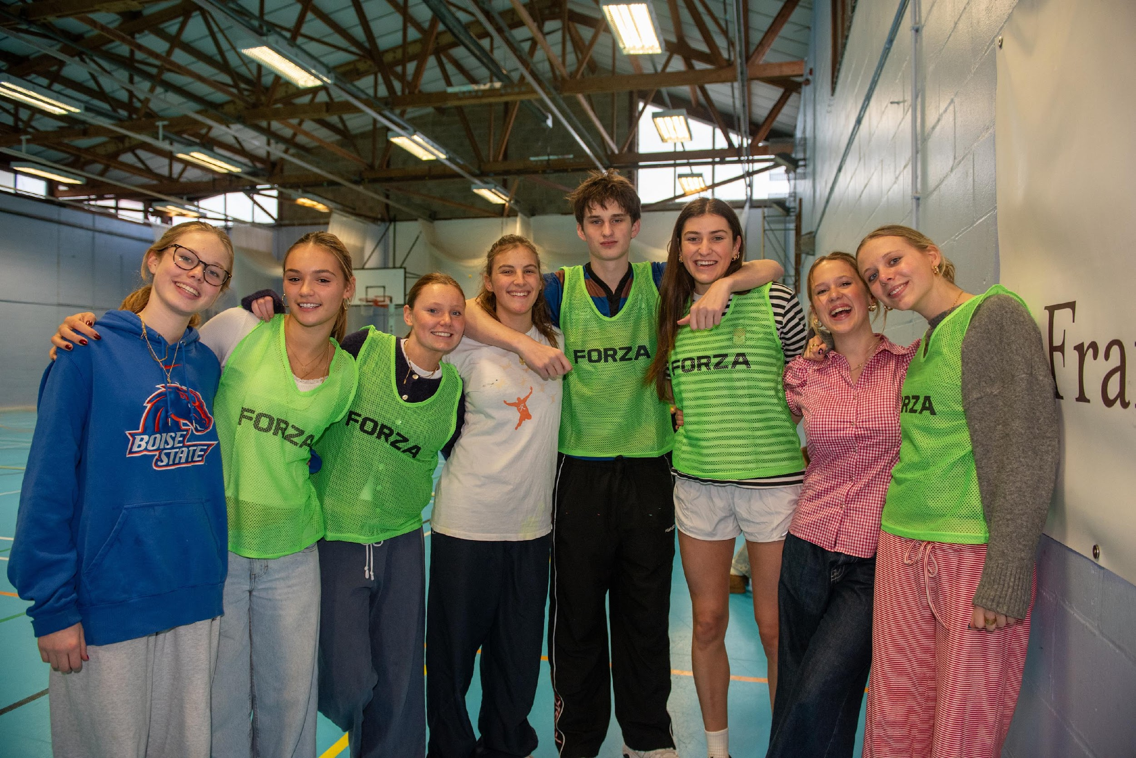
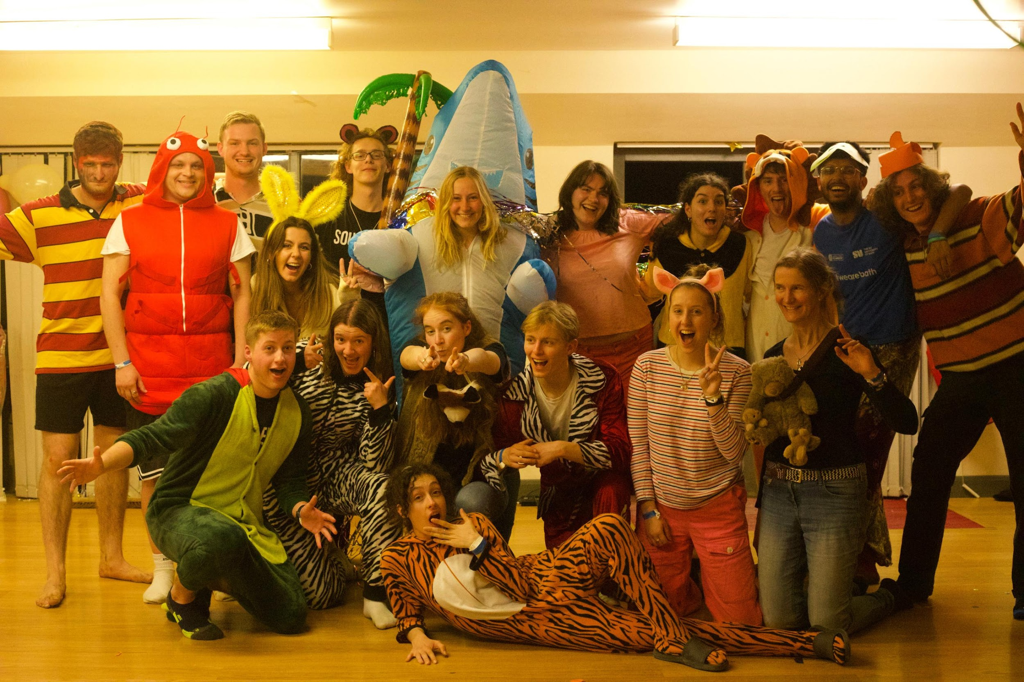
  AVOID ARTIFICIAL
  LIGHT

Slide 8
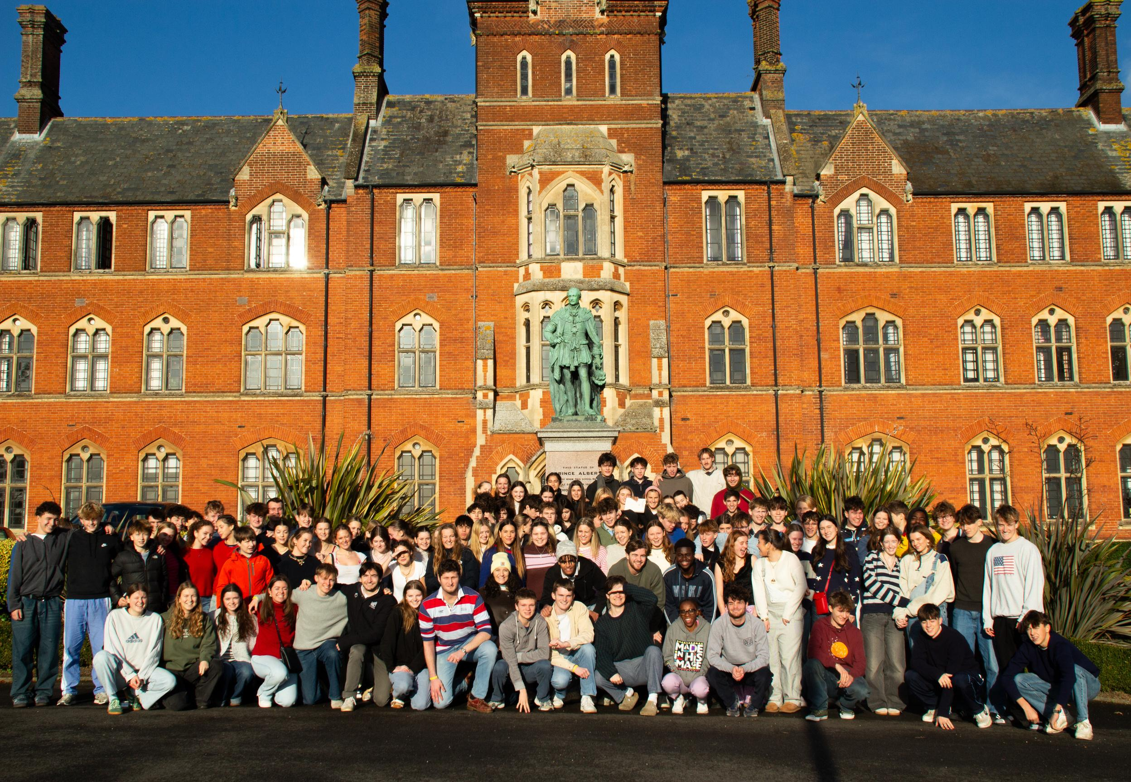
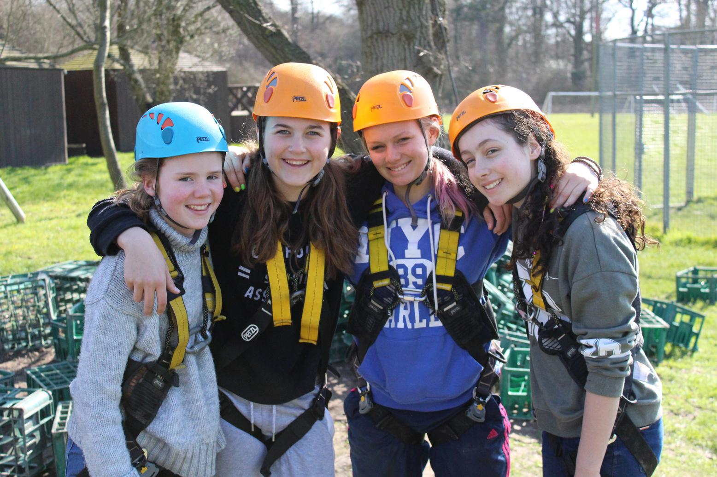
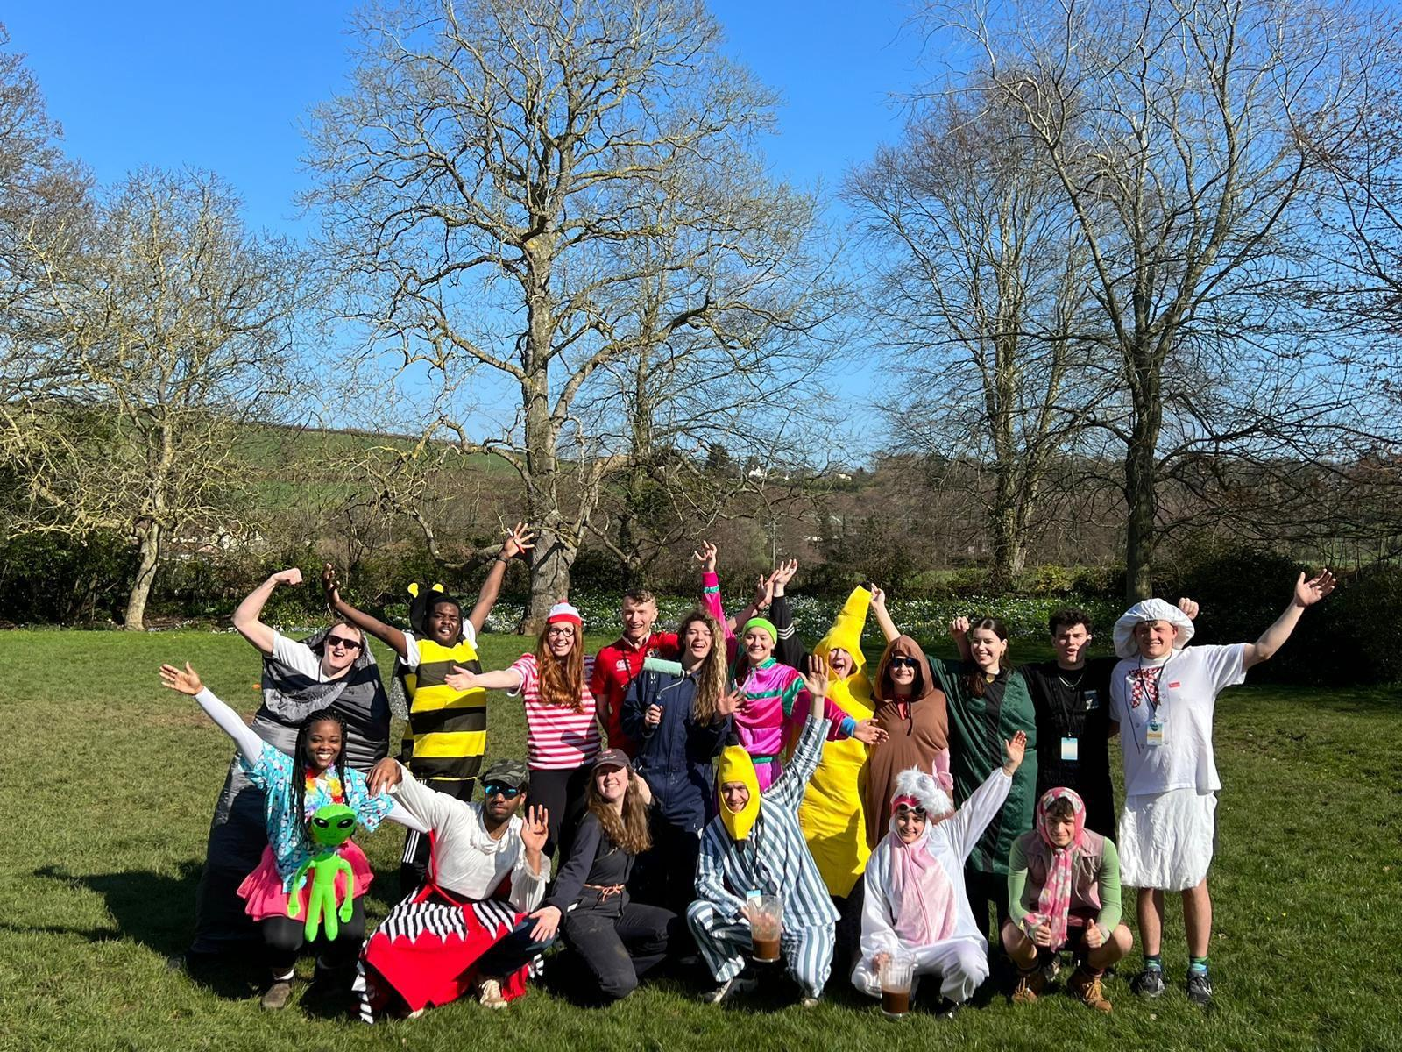
  GROUPS
  Avoid lots of large group photos
  Small group photos used more

Slide 9
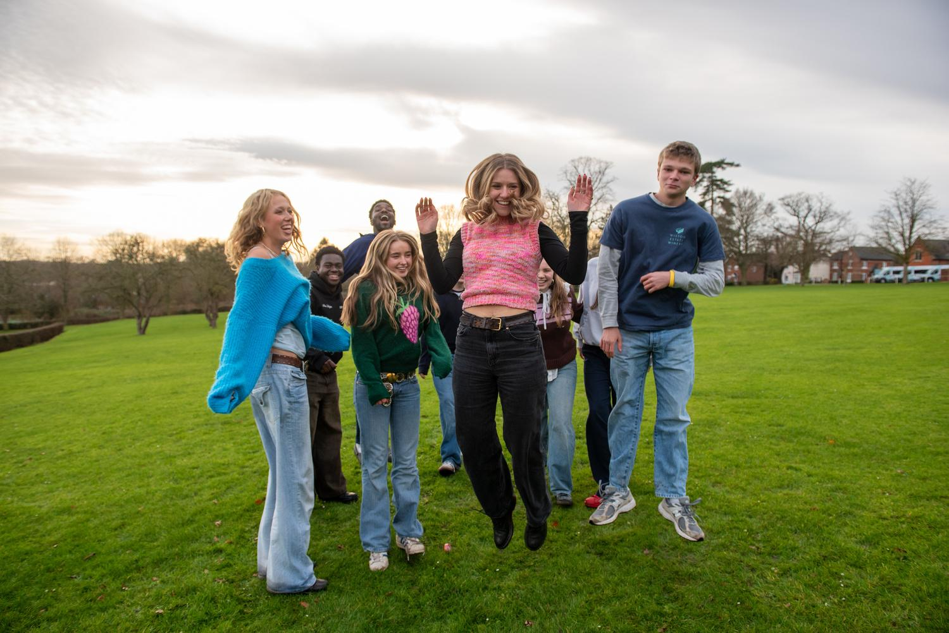
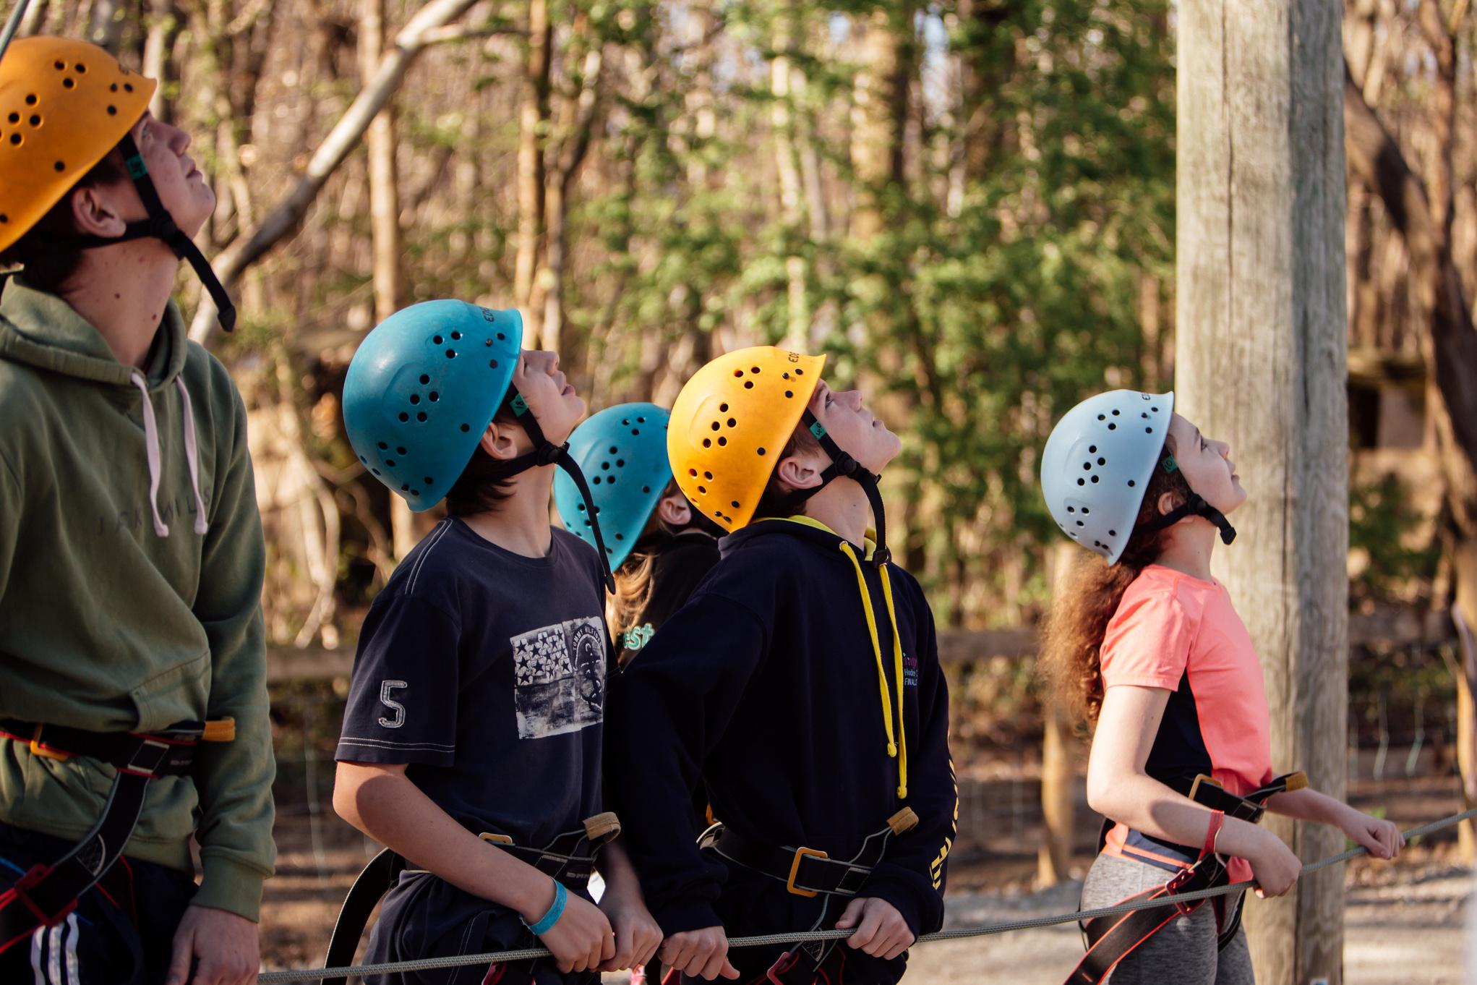
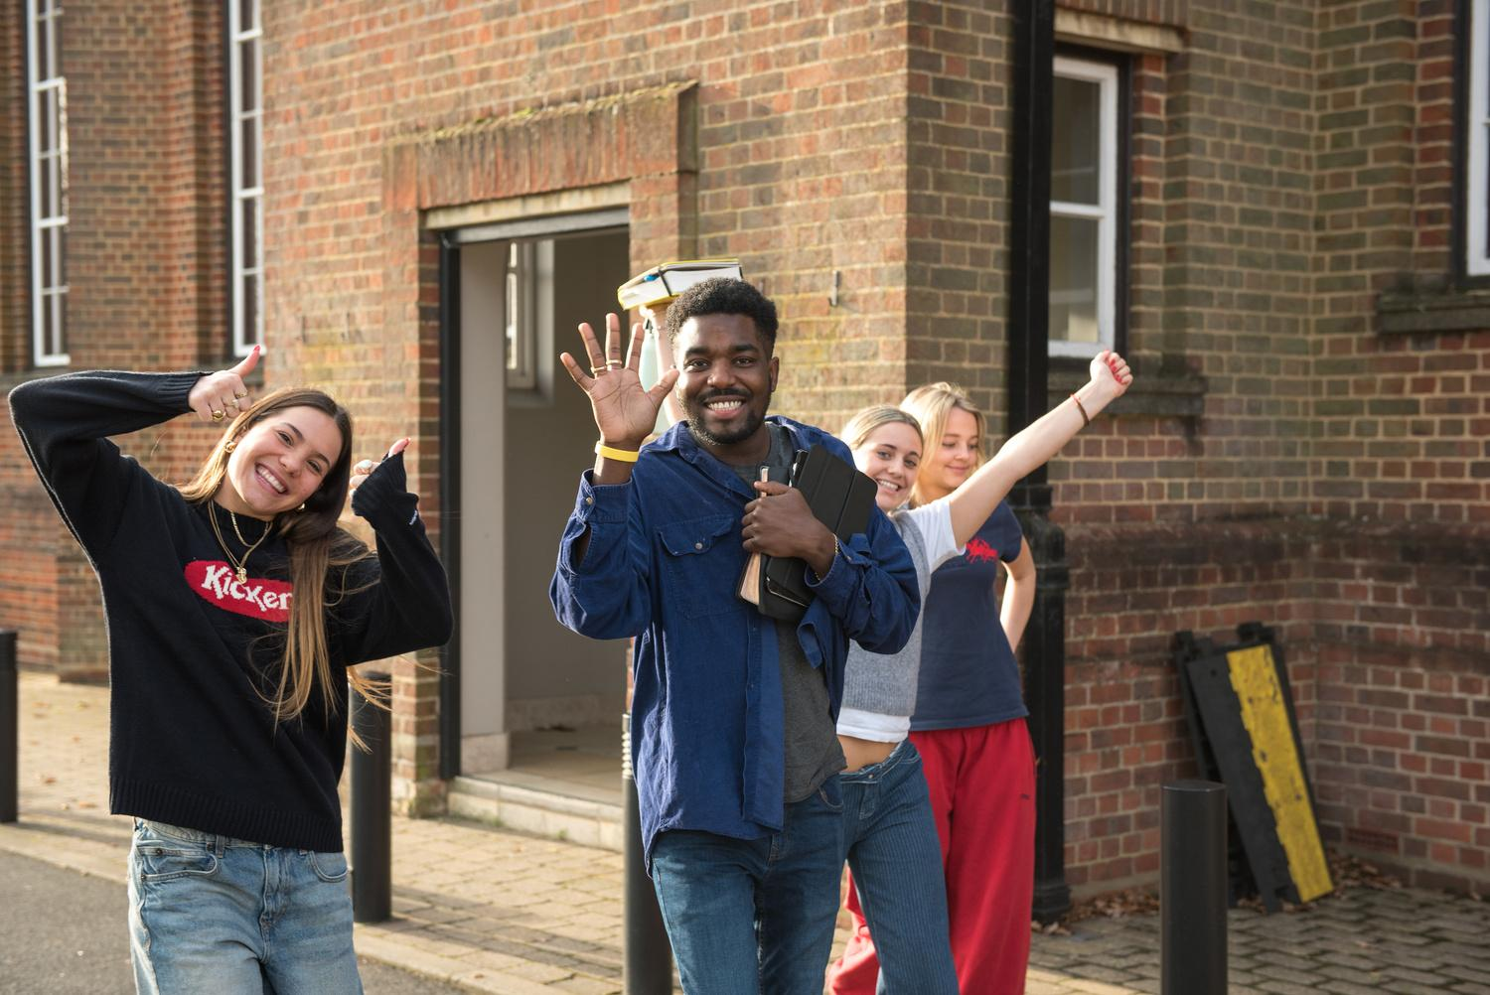
  FUN
ENGAGING
  AUTHENTIC

Slide 10
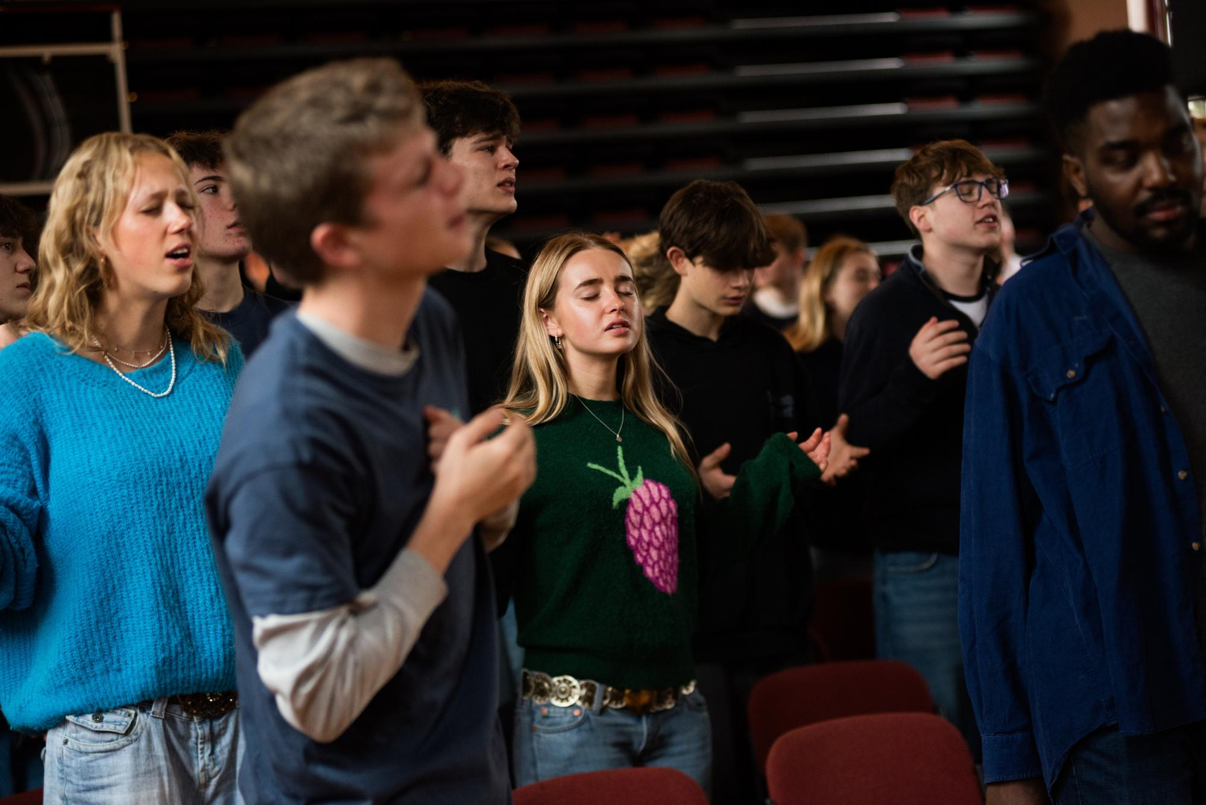
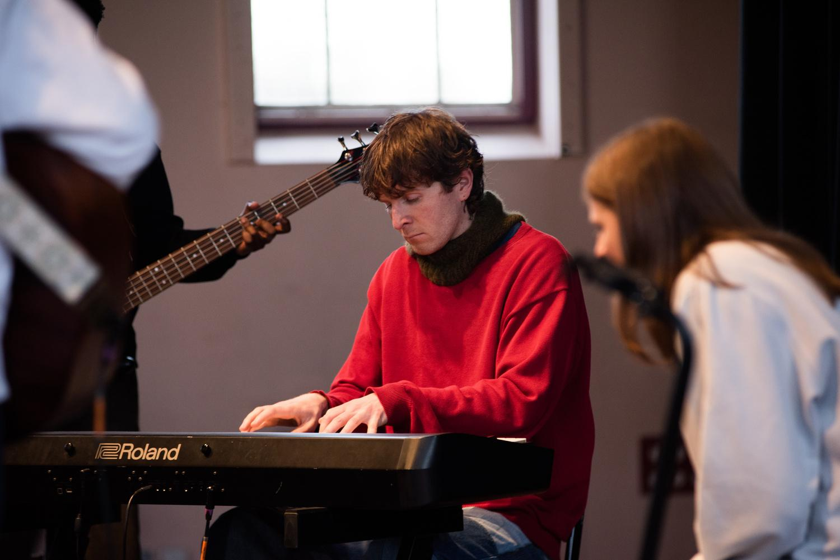
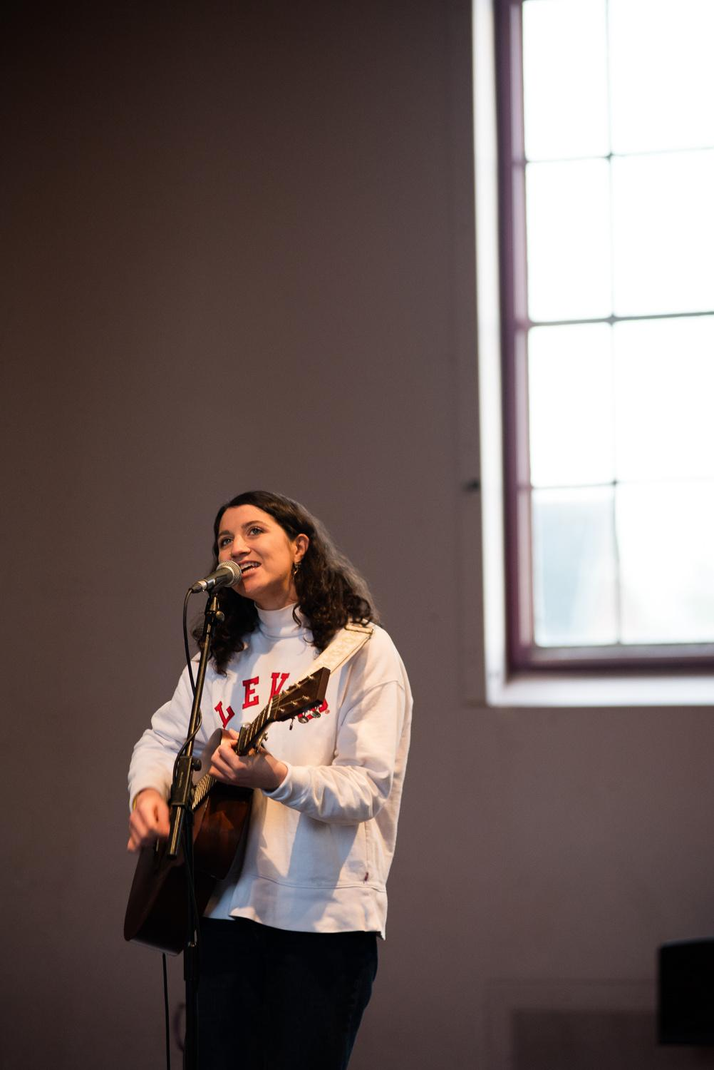
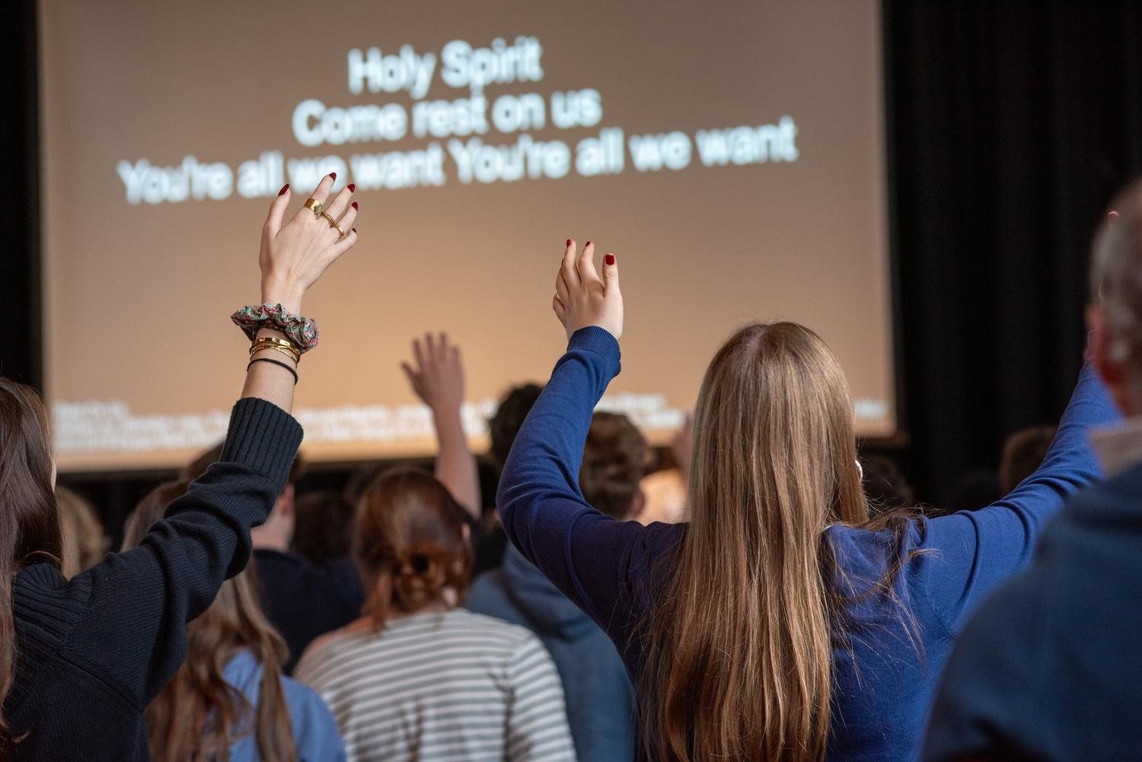
  WORSHIP

Slide 11
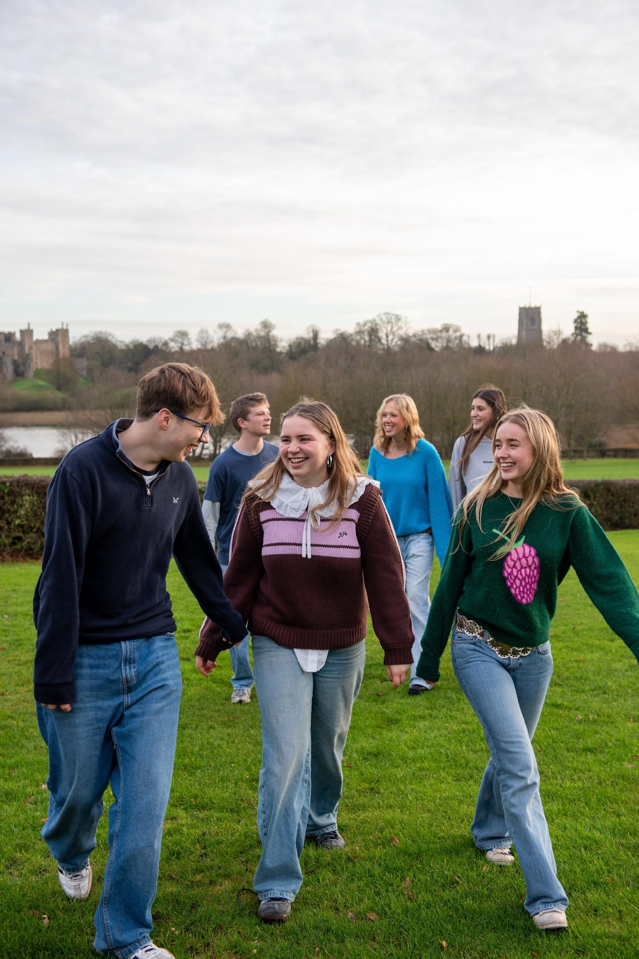
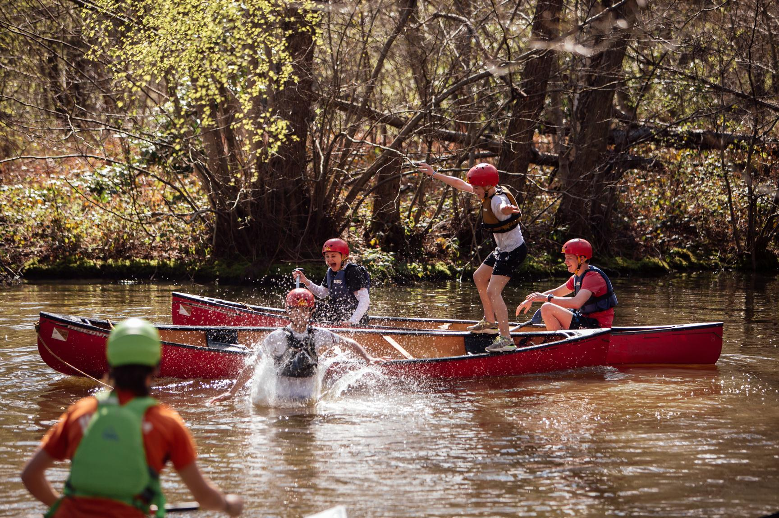
ACTION
ENERGY
REACTIONS

Slide 12
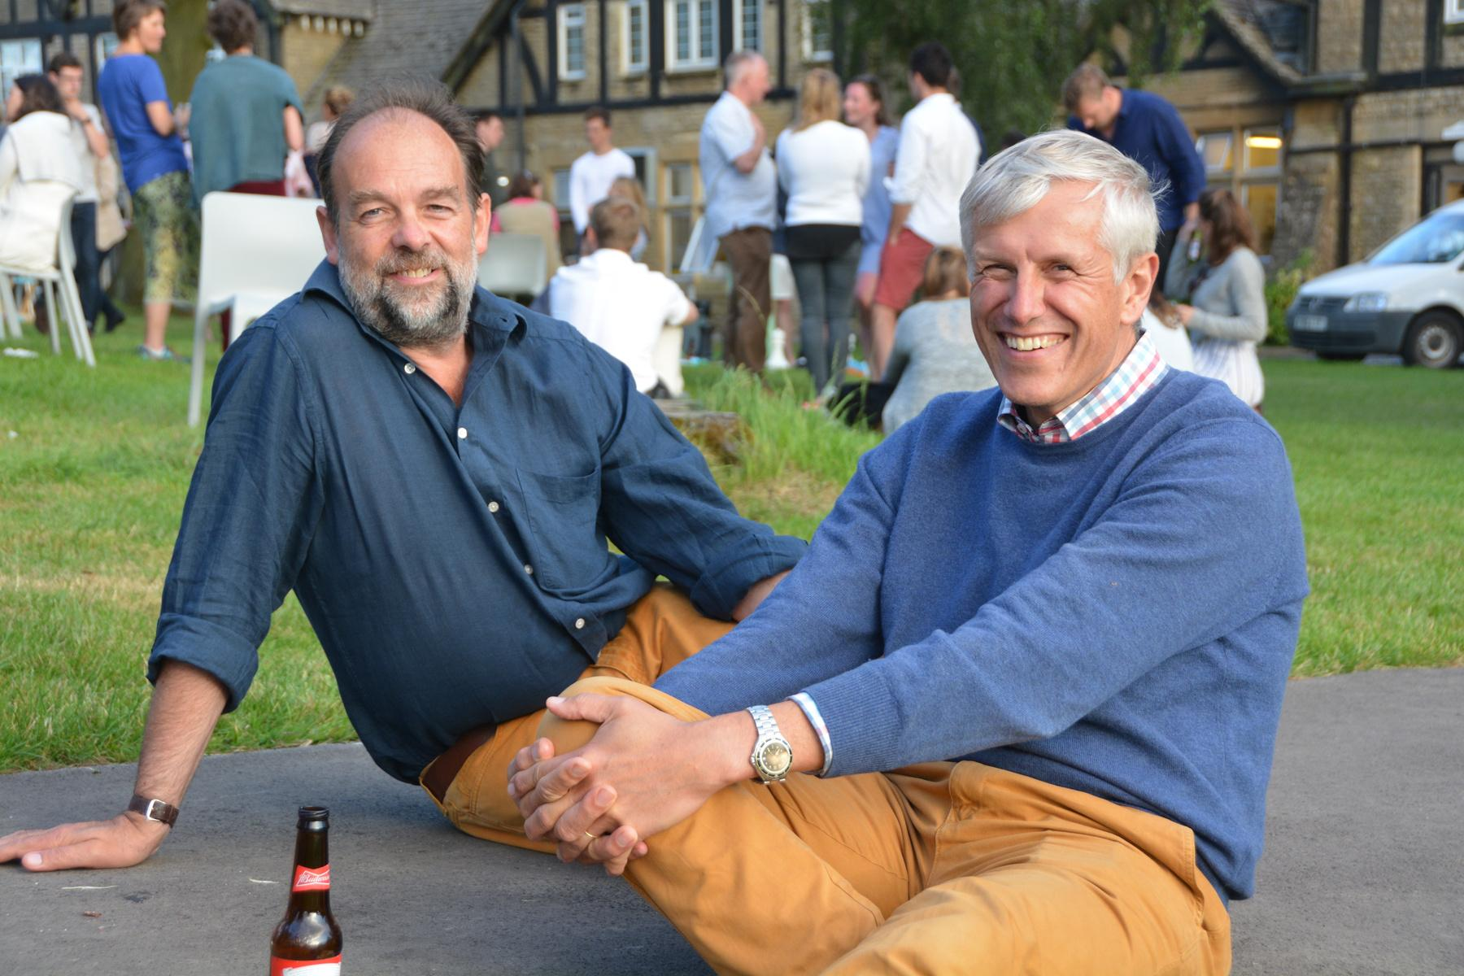
ATHENTIC
  DYNAMIC
SMILING FACES

Slide 13
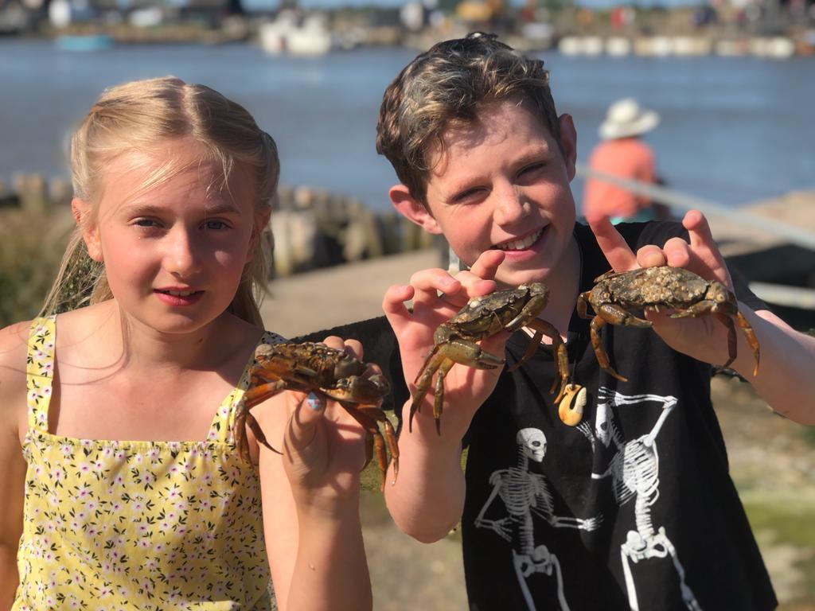
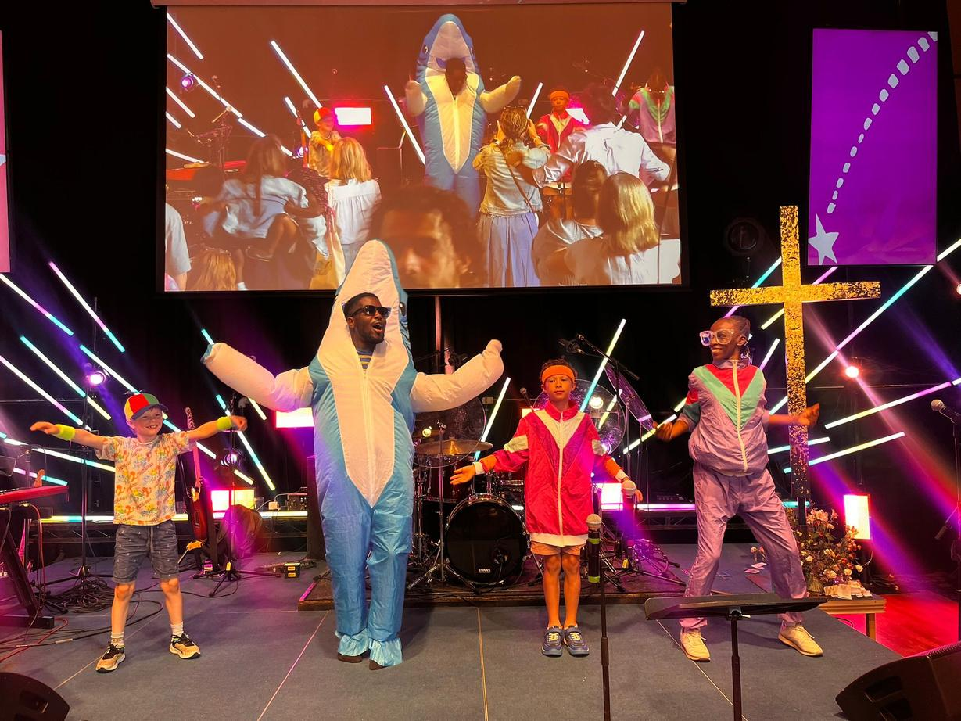
WIDE SHOTS
CLOSE-UPS

Slide 14
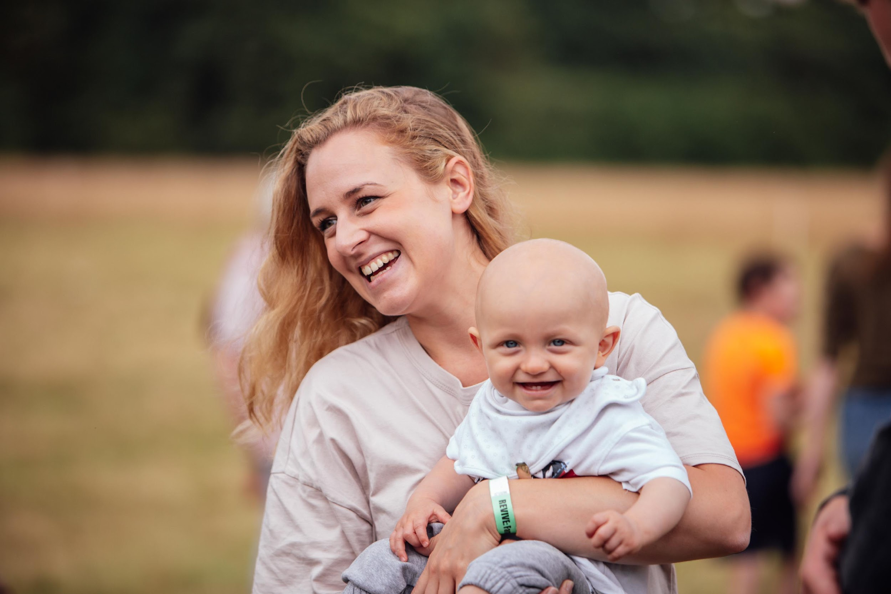
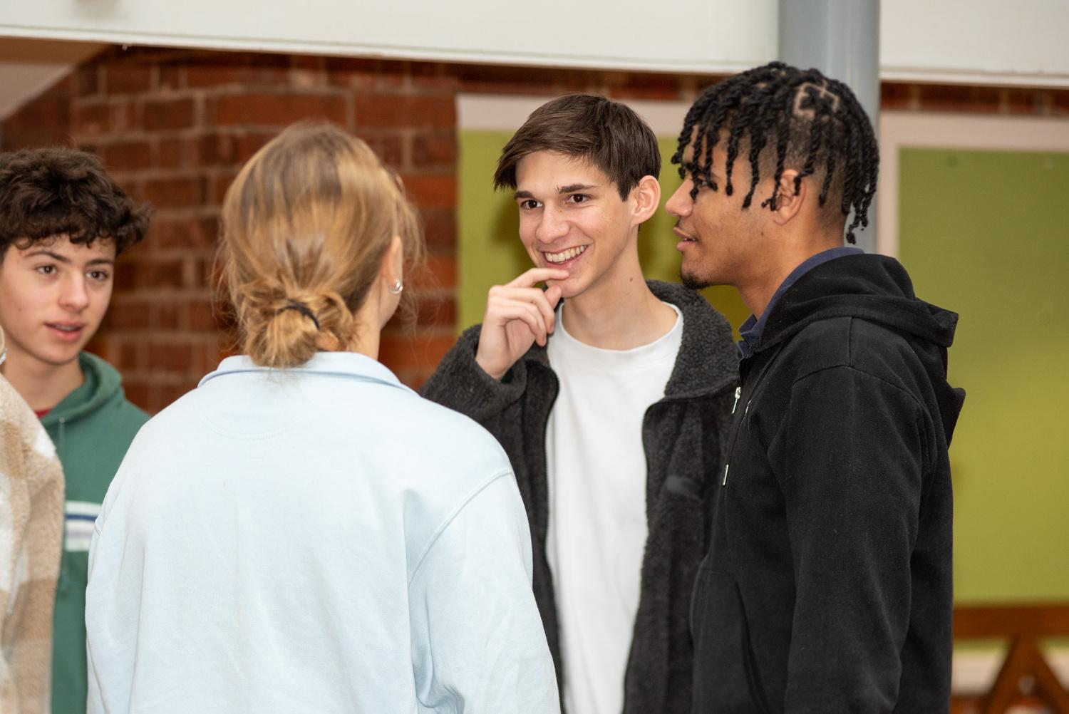
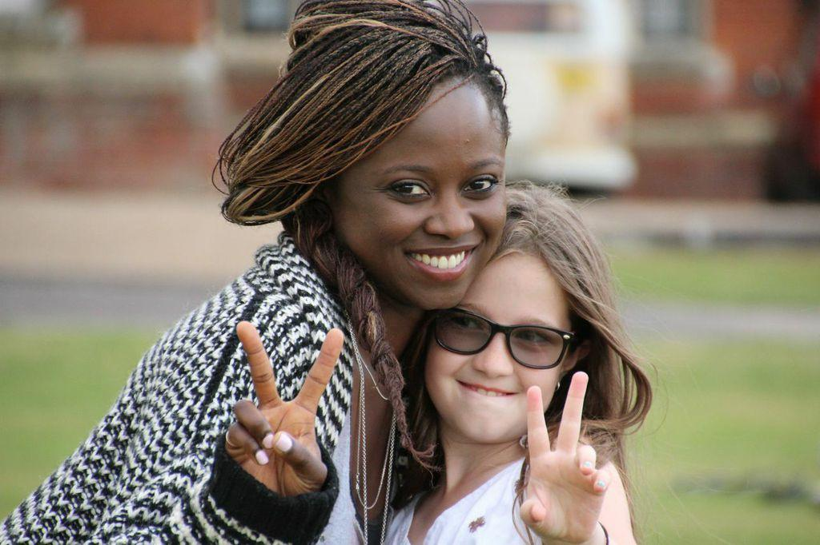
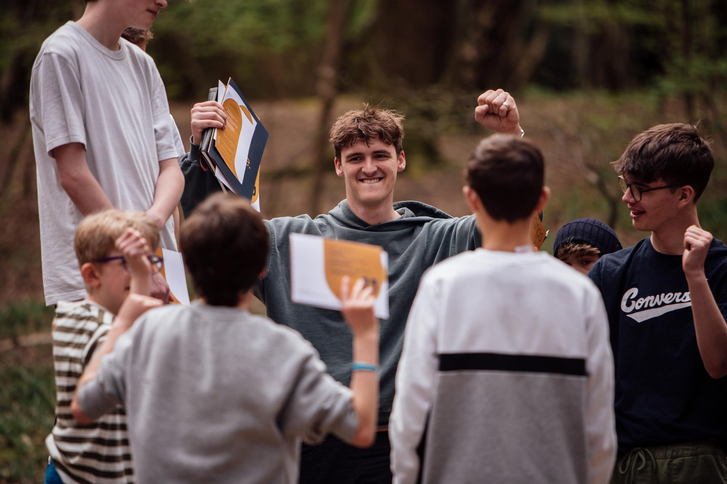
RELATIONSHIP
  INTERACTIONS

Slide 15
  THANK YOU FOR BEING OUR CAMP PHOTOGRAPHER

